Slide 1


Slide 2

Group Members
Muhammad Ahsan
Muhammad Usman
Fatima Saad Naik

Slide 3

Society Sphere
We Shape the future of society together

Slide 4
Advantages
Streamlined Communication
Efficient Event Management
Transparent Leadership Assignments
Enhanced Member Management
Continuous Improvement

Slide 5

Non-Functional Requirements
Protect User Data
Professionally written code
Portable

Slide 6
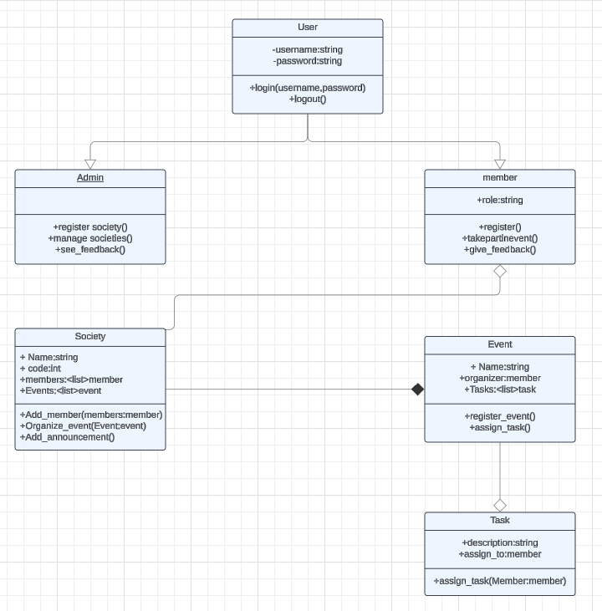
Design
Class Diagram

Slide 7
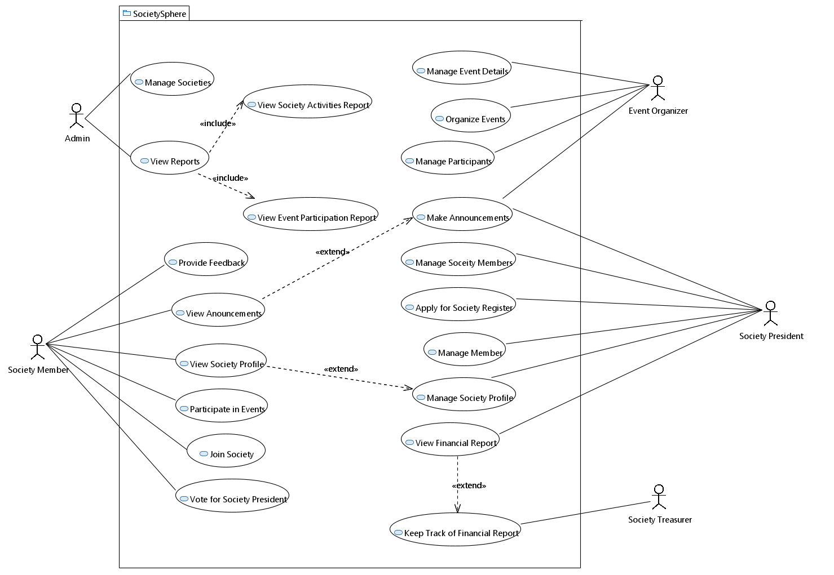
Use case diagram

Slide 8
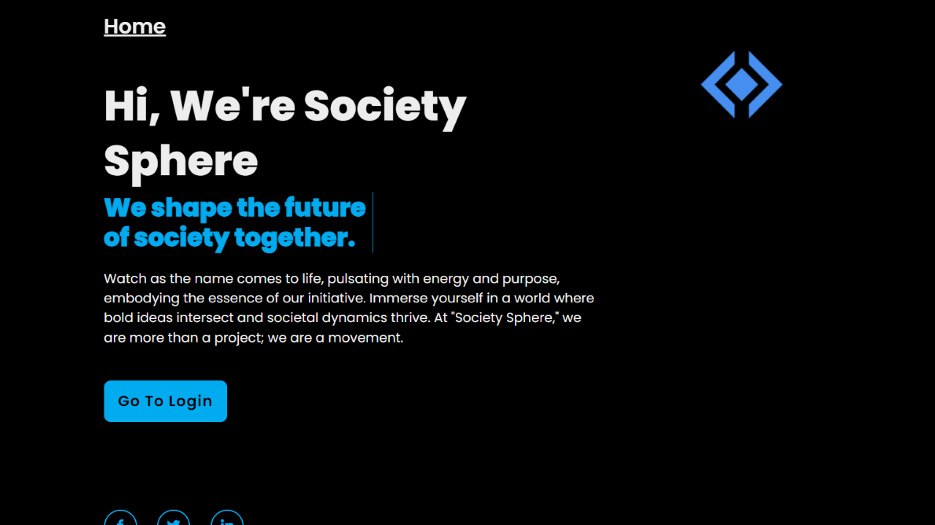

Slide 9
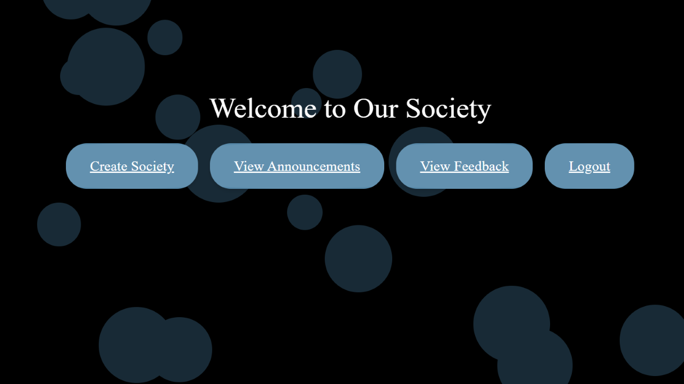

Slide 10
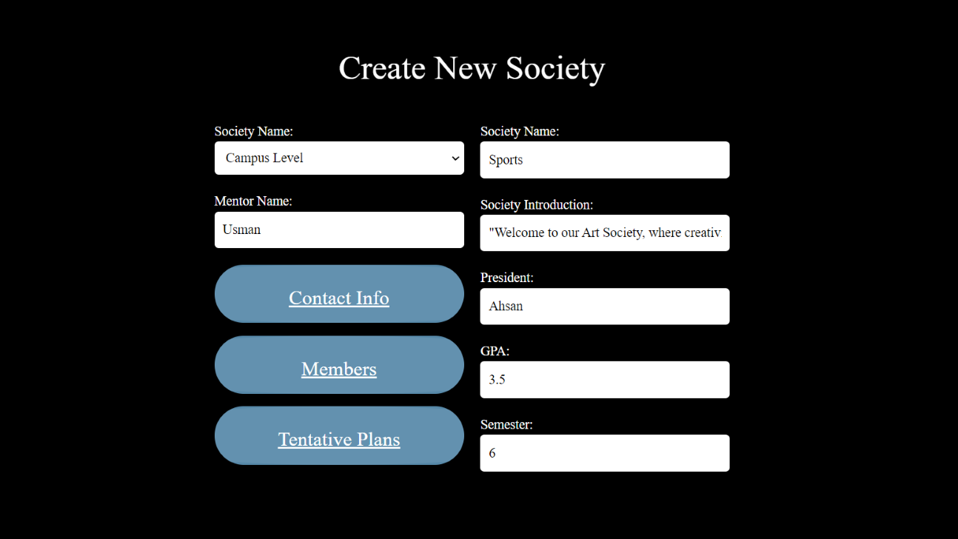

Slide 11
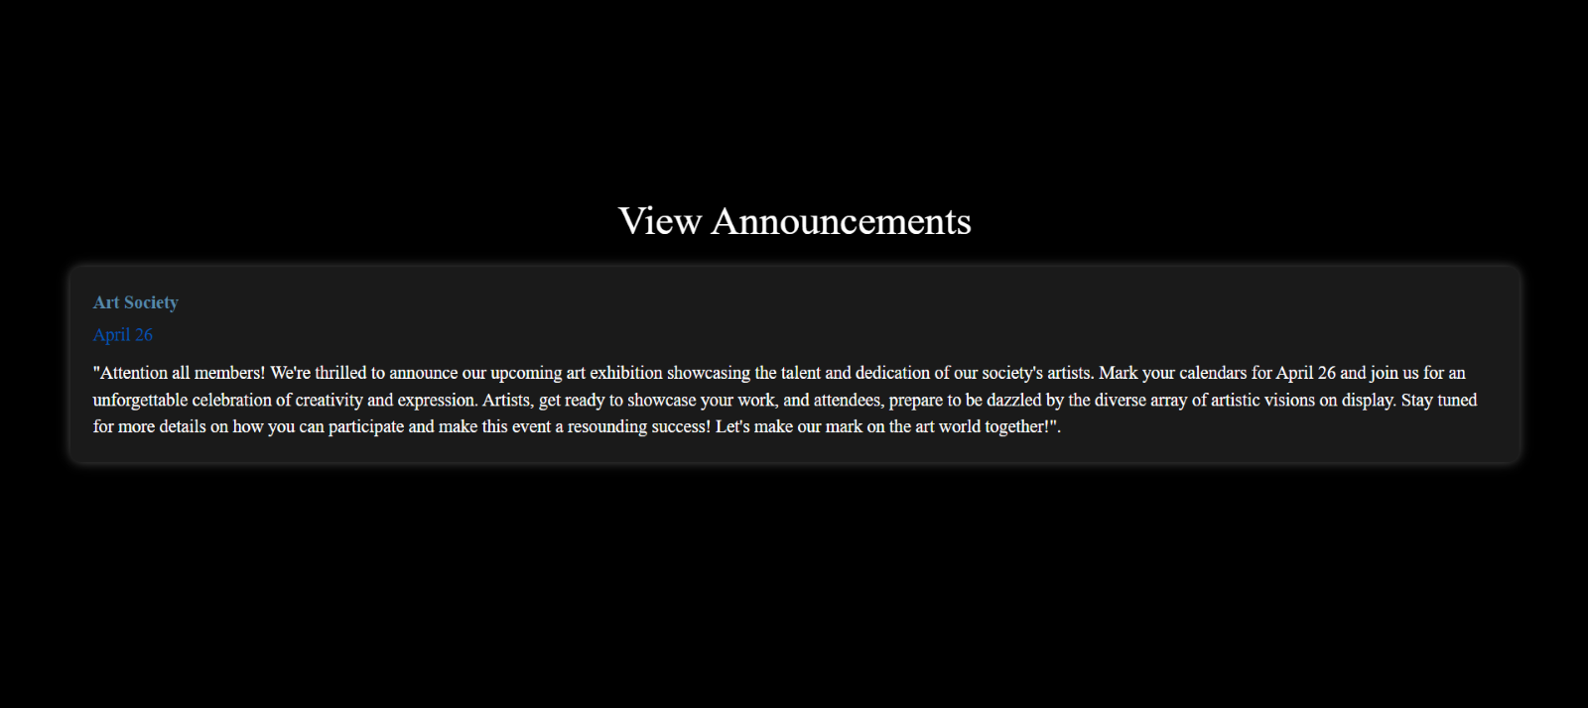

Slide 12
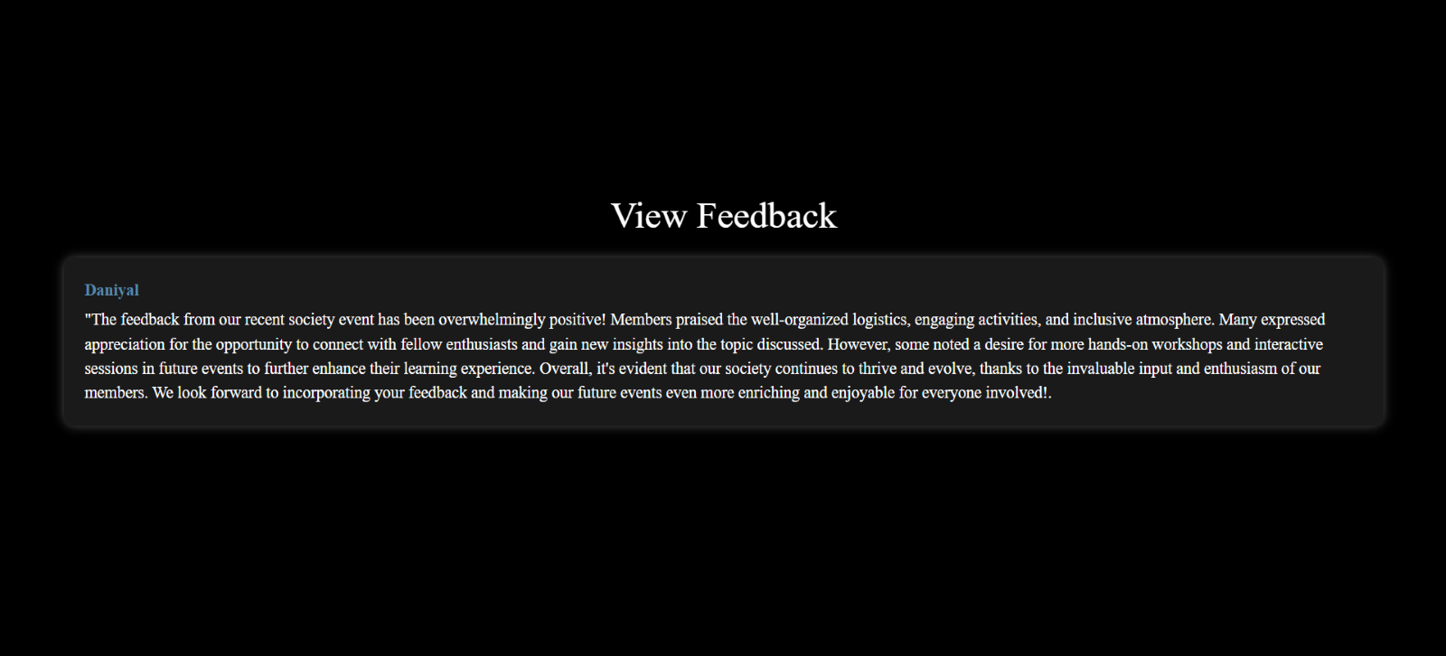

Slide 13
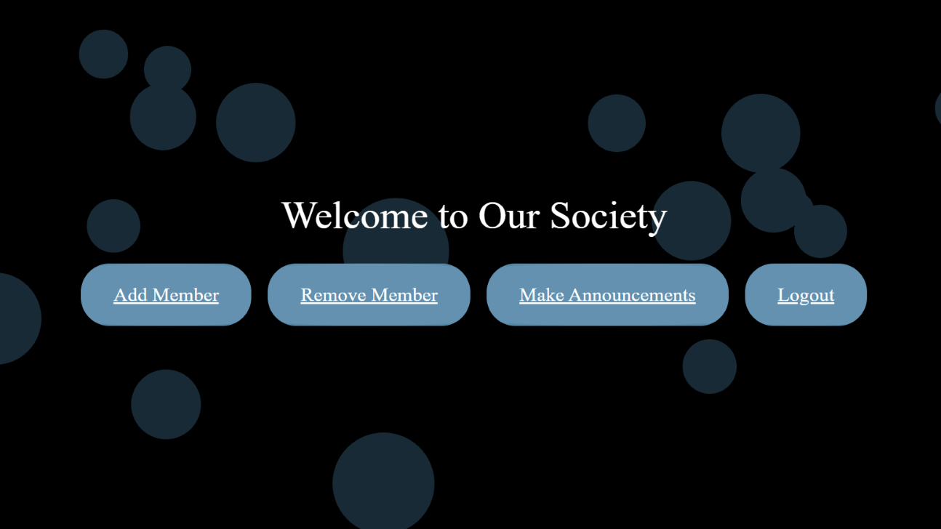

Slide 14
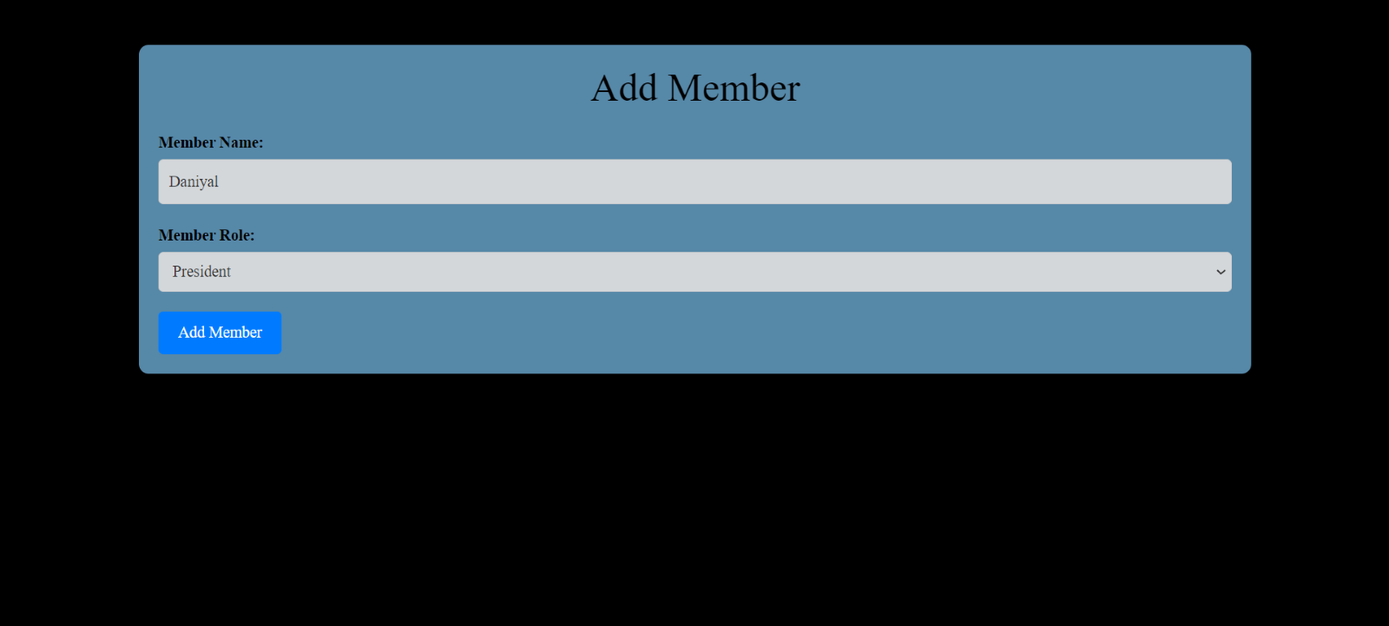

Slide 15
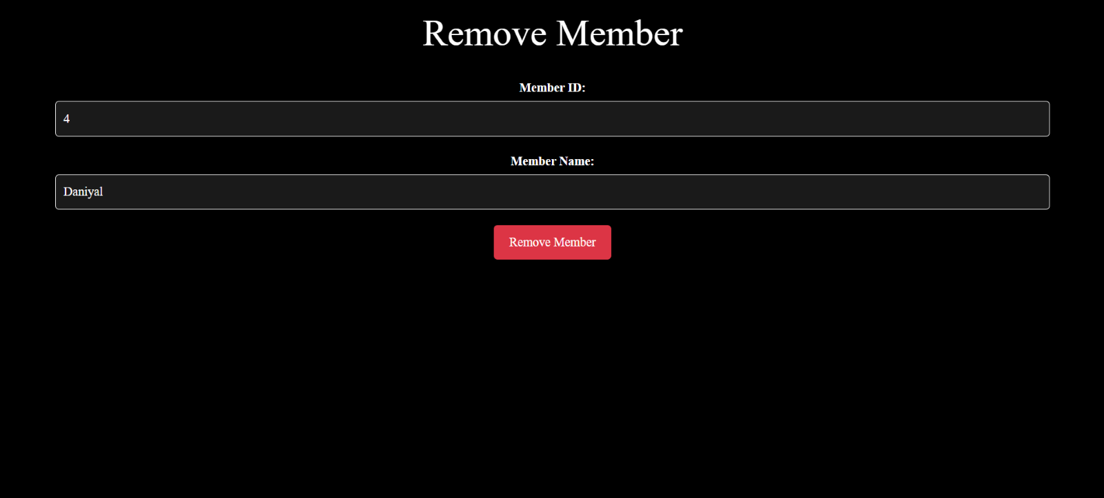

Slide 16
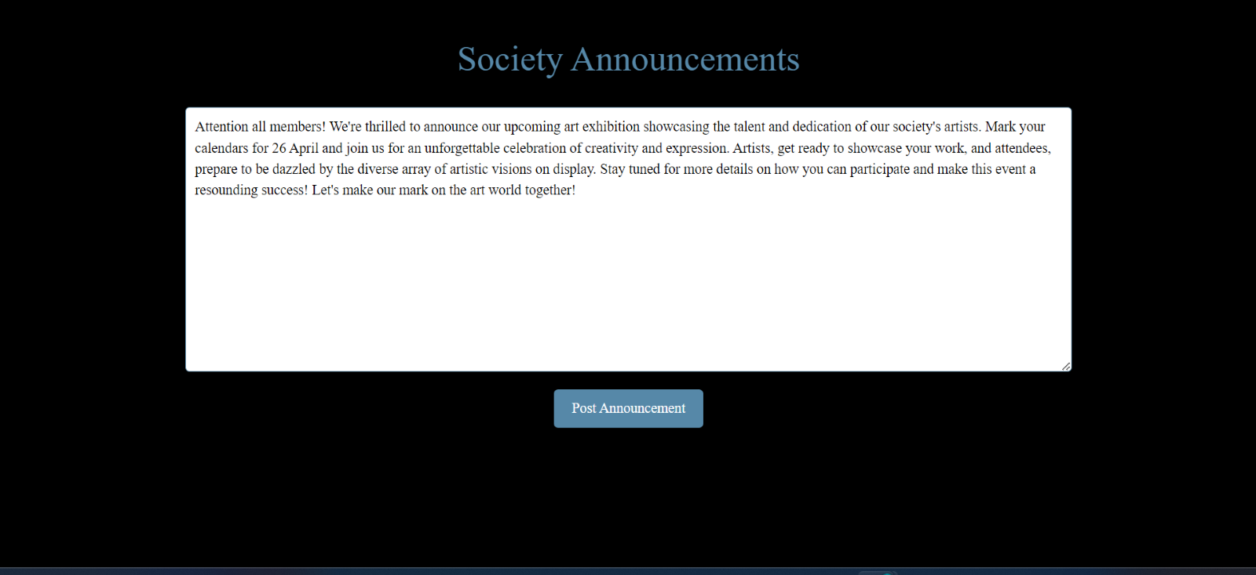

Slide 17
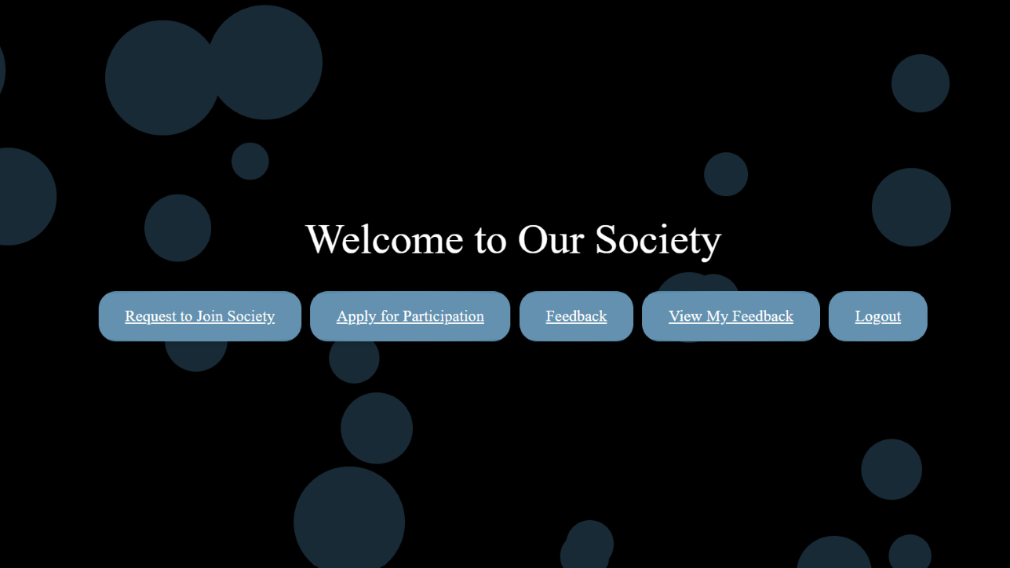

Slide 18
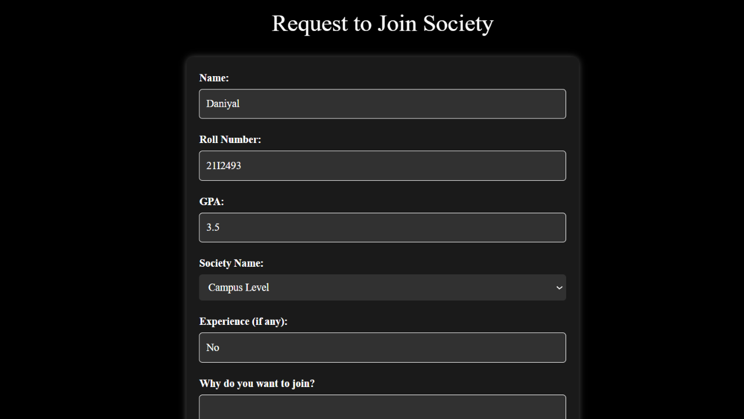

Slide 19
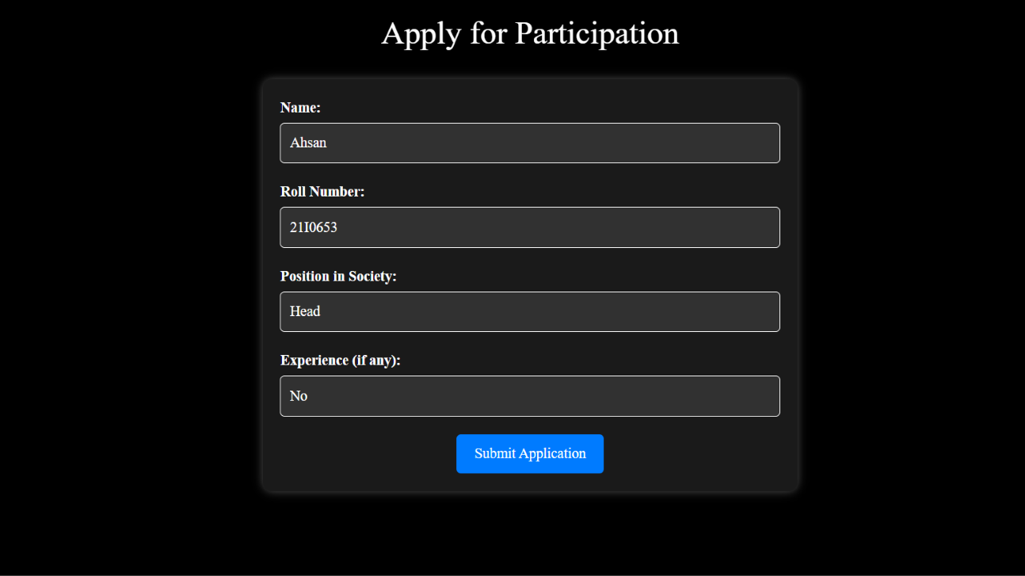

Slide 20
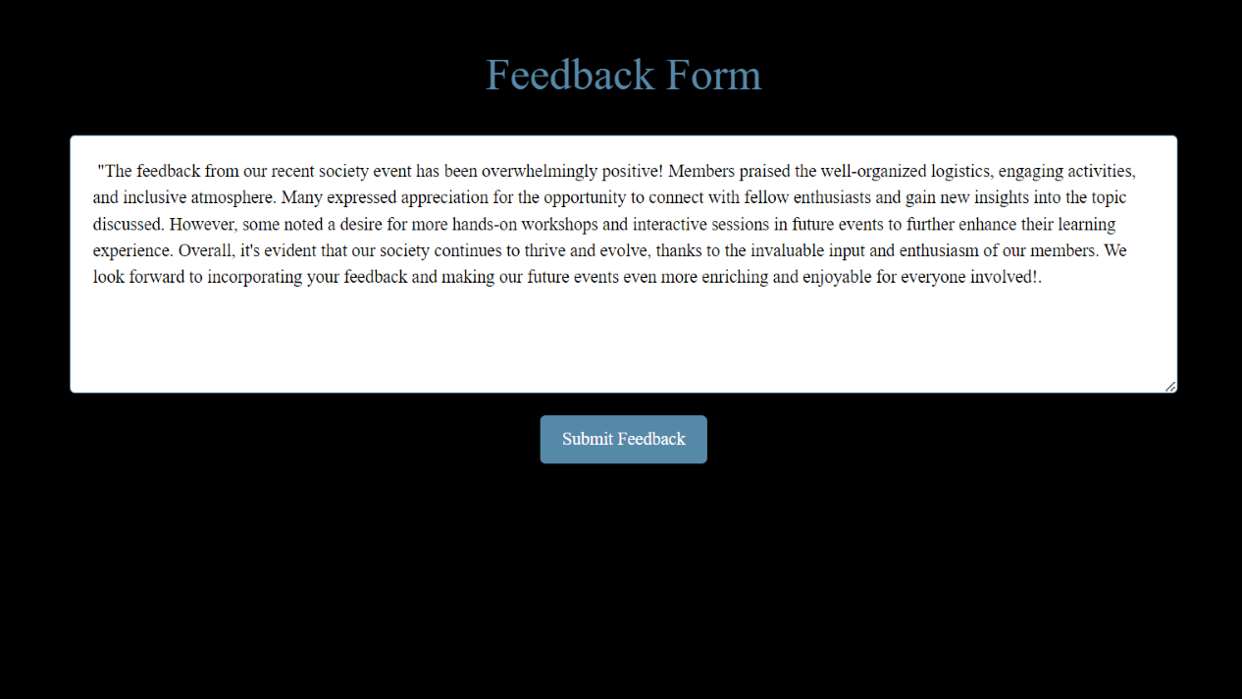

Slide 21
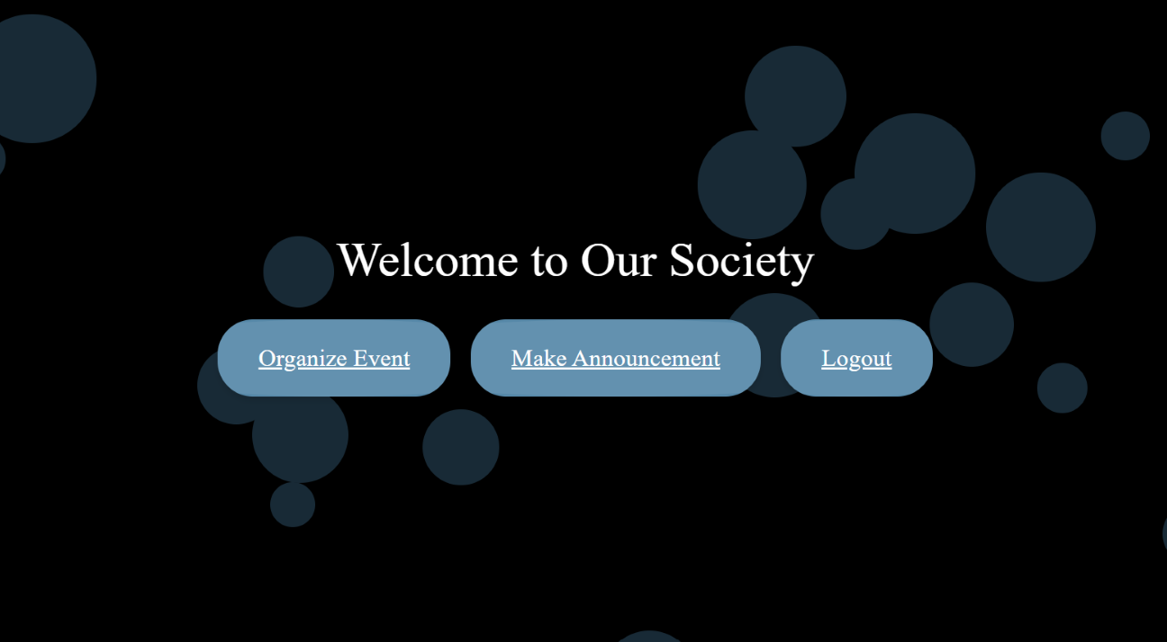

Slide 22
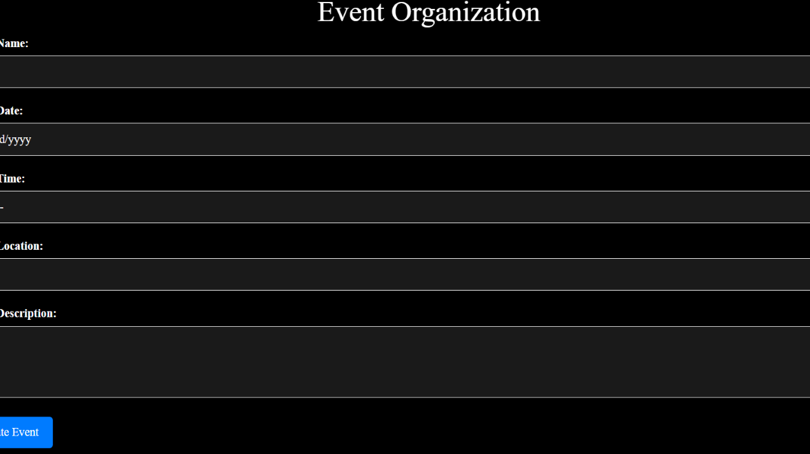

Slide 24
Work Division:
Name | Work Done
Muhammad Ahsan | User stories along with their substories, Activity diagrams, documentation, testing.
Muhammad Usman | Use case diagram, class diagram Backend code of the project.
Fatima Saad Naik | Sequence diagrams, User stories and implementation of GUI

Slide 25
Lesson Learnt:
We must respect each group member so we can work together easily.
We should increase communication in our group to timely overcome the issues.
When we are in a group then the testing of different people leads to early bug caching that makes the quality of our project best.

Slide 26


